Slide 1
BUSINESS PRESENTATION
visit us at electi.club
Notes:
Experience the remarkable benefits of the world’s most innovative products. Designed with Swiss precision to meet exacting standards for efficacy, quality, and safety, there is nothing like it.

Slide 2
Choice is yours.
HEALTH. WEALTH. HAPPINESS.
visit us at electi.club

Slide 6
Lack of micronutrients is a
major global health problem.
visit us at electi.club

Slide 7
By the end of this century our food will be so empty, that it will be no longer useful for human consumption. It will only fill the human stomach and not be able to truly nourish humans.
Rudolf Steiner 1921
visit us at electi.club

Slide 9
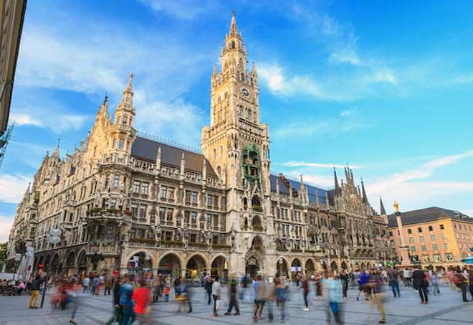
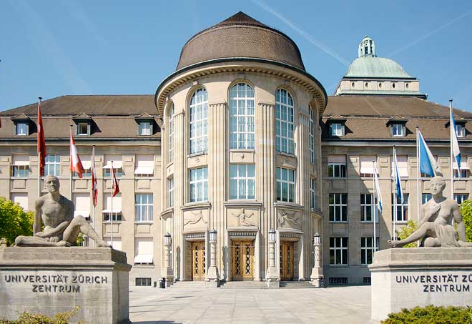
ESTABLISHED UNIVERSITY PARTNERSHIPS
University of Ljubljana
University of Munich
University of Zurich
University of Ljubljana is the oldest and largest higher education and scientific research institution in Slovenia.
A technical university of Munich that specialises in engineering, technology, medicine, and the applied and natural sciences, it is organised into 11 schools
and departments, and supported by numerous research centres.
The University of Zurich is one of the most prestigious research institutions in Europe, with a strong reputation in medicine, immunology, biology, genetics, and neuroscience.
visit us at electi.club

Slide 11
Cellular Absorption
PureCell™ technology brings orally taken nutrients to the cell in a fast, safe, and efficient way.
vs.
Normal Nutrient
PureCell™ Enhanced Nutrient
Inability of nutrient to pass the cell membrane
Encapsulated nutrients are better able to pass the cell membrane
visit us at electi.club

Slide 13
Peak Immunity
pure cell
Powerful immune support to keep you at your best.
Peak Immunity combines the benefits of Vitamin C with a proprietary blend of Cur cumin and Frankincense to deliver anti-inflammatory and immune support. These three natural ingredients work together to boost your overall wellness and keep you in the game all year round.
Retail : €66.00
Club Member : €55.00
visit us at electi.club

Slide 14
Choice Multivitamin
pure cell
Fill nutritional gaps and fuel your day.
Even with a highly optimised diet of nutrient-rich foods, it’s very difficult to get the essential vitamins and minerals we need every day. And if you’re like most people, with a fast-paced lifestyle, it’s even harder to find time to prepare the perfect meal three times a day.
Retail : €51.50
Club Member : €43.00
visit us at electi.club

Slide 15
Beaming Youth
pure cell
Activate, preserve, and protect your cells from aging.
The key to looking and feeling younger starts with the ability of our cells to get rid of the cellular waste that builds up as we age. This process, called autophagy, rids your cells of unwanted material so that they can operate at peak levels of efficiency.
Retail : €51.50
Club Member : €43.00
visit us at electi.club

Slide 16
D3 Defence
pure cell
Protect, Balance and Regenerate.
Vitamin D is often called “the sunshine vitamin” because it can be naturally produced in your body following exposure to the sun. Among its many benefits, Vitamin D can promote bone growth, regulation of muscle function, and the conversion of blood sugar into energy.
Retail : €46.80
Club Member : €39.00
visit us at electi.club

Slide 17
Smart Energy
pure cell
Boost your body and your brain.
One of your body’s secret weapons for producing energy in the form of ATP is a naturally-occurring substance called Coenzyme Q10, or CoQ10 for short.
Retail : €58.80
Club Member : €49.00
visit us at electi.club

Slide 18
The PureCell™ Difference
A breakthrough process which allows for a consistent, effective dose of key nutrients.
Highest efficiency and safety
Fast-acting (rapid onset of effects)
Good safety
profile
1/1000th
of the size of
a human cell
Easy and precise dosing
Simple daily intake
Potent formulation
visit us at electi.club

Slide 20
What can I buy with my Electi Credits?
Buy Everyday Drops and
future Electi health products.
Buy tickets to a live Electi events.
Buy Electi Travel Vouchers
to save around the world.
visit us at electi.club

Slide 21
Choose Wealth
Formal education will make you a living.
Self education will make you a fortune.
visit us at electi.club

Slide 22
Find three people - and yours is free.
3
free
visit us at electi.club

Slide 23
find three
3
9
27
81
€99
Who finds three
Who finds three
QVP 12,000
€1,200 / M
Who finds three
( €14,400 / year )
visit us at electi.club

Slide 24
find three
3
9
27
81
€499
Who finds three
Who finds three
QVP 60,500
€7,000 / M
Who finds three
( €84,000 / year )
visit us at electi.club

Slide 25
Compensation Plan Summary
Bronze
Silver
Gold
Emerald
Sapphire
Ruby
( 300 QVP )
( 1,200 QVP )
( 3,000 QVP )
( 7,500 QVP )
( 20,000 QVP )
( 50,000 QVP )
1 Personal Customer or Club Member
2 Personal Customers or Club Members
3 Personal Customers or Club Members
4 Personal Customers or Club Members
5 Personal Customers or Club Members
40% Rule
40% Rule
40% Rule
40% Rule
40% Rule
€ 100
€ 400
€ 700
€ 1,200
€ 3,000
€ 7,000
Monthly Reward
Monthly Reward
Monthly Reward
Monthly Reward
Monthly Reward
Monthly Reward
+€100
Speed
Bonus
Club Commission
Monthly Rank Rewards
Matching Bonus
Earn 20% commission on personal customers purchases.
Earn a monthly bonus based on your paid rank at the end of the month.
3 personals = 1%
10 personals = 6%
20 personals = 12%
5 personals = 3%
15 personals = 9%
visit us at electi.club

Slide 26
Compensation Plan Summary
AMBASSADOR LEVELS
Ambassador
Ambassador
Ambassador
Diamond
Global
ONE STAR
TWO STAR
AMBASSADOR
AMBASSADOR
( 125,000 QVP )
( 250,000 QVP )
( 500,000 QVP )
( 1,500,000 QVP )
( 3,000,000 QVP )
6 Personal Customers or Club Members
7 Personal Customers or Club Members
8 Personal Customers or Club Members
9 Personal Customers or Club Members
10 Personal Customers or Club Members
40% Rule
40% Rule
40% Rule
40% Rule
40% Rule
€ 15,000
€ 30,000
€ 60,000
€ 150,000
€ 350,000
Monthly Reward
Monthly Reward
Monthly Reward
Monthly Reward
Monthly Reward
visit us at electi.club

Slide 27
Elevate by Electi
On-demand Personal Development content library including e-books, videos, audios, podcasts and more. Live and on-demand virtual training events.
visit us at electi.club

Slide 28
Travel in style and save money
with Explōre by Electi experiences.
A complete integrated portal for your daily activities and leisure.
visit us at electi.club

Slide 29
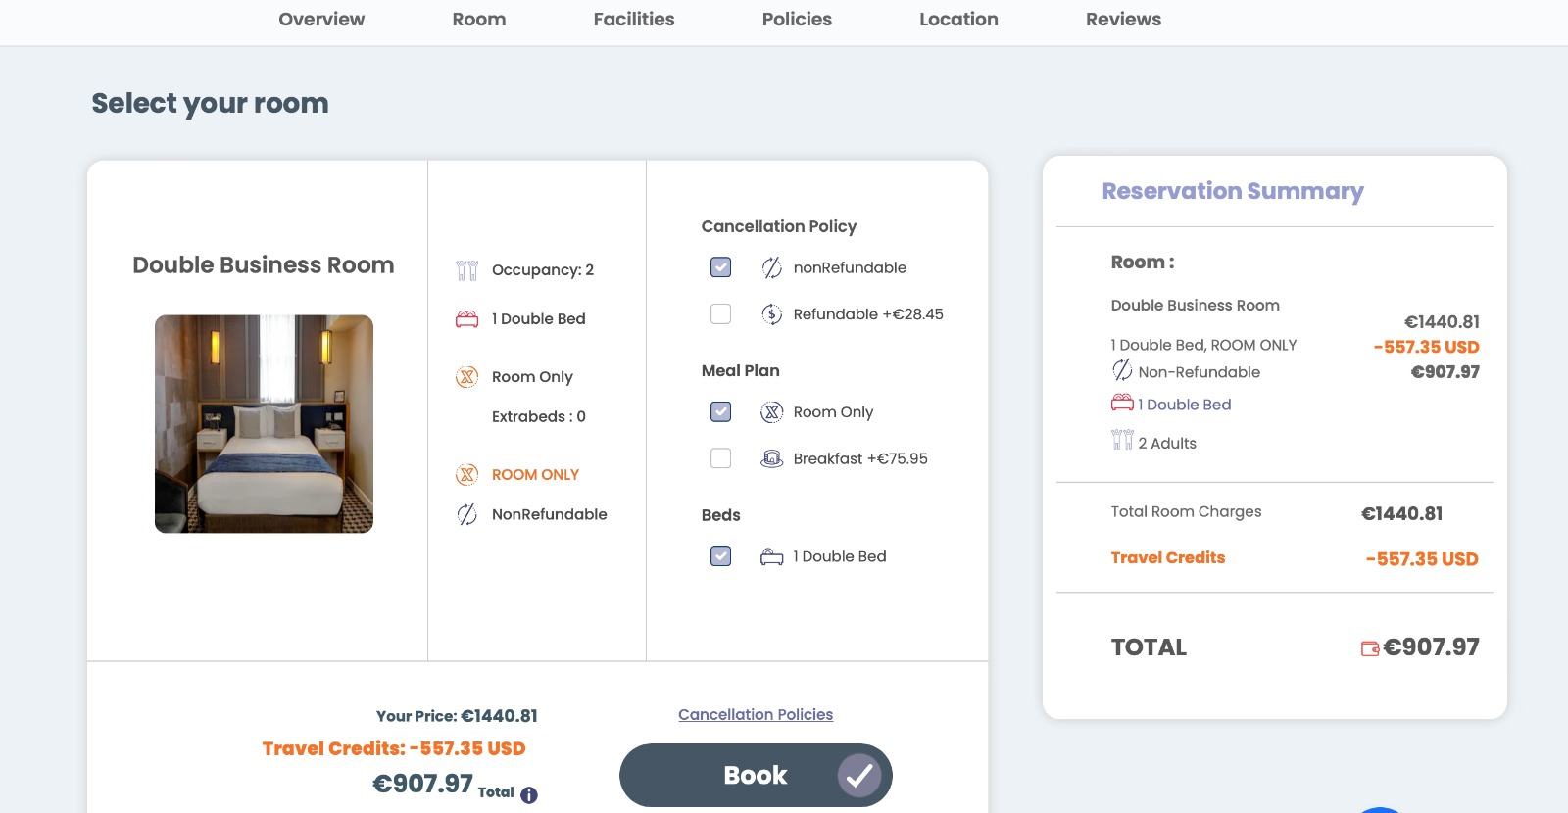

Slide 30
Sign up
Goals
Products
Name list
Invite
Present
Educate
7
Steps
visit us at electi.club

Slide 31
Choice is Yours.
Start your new journey today.
visit us at electi.club

